Slide 1
Test-Lab for Art-AIs

Slide 2
Exercise: Testin Art-AIs
Choose with your partner one app that you want to try.
Answer the questions on the questionaire while you‘re testing the app
Save your artworks, so that you can present them later in class.

Slide 3
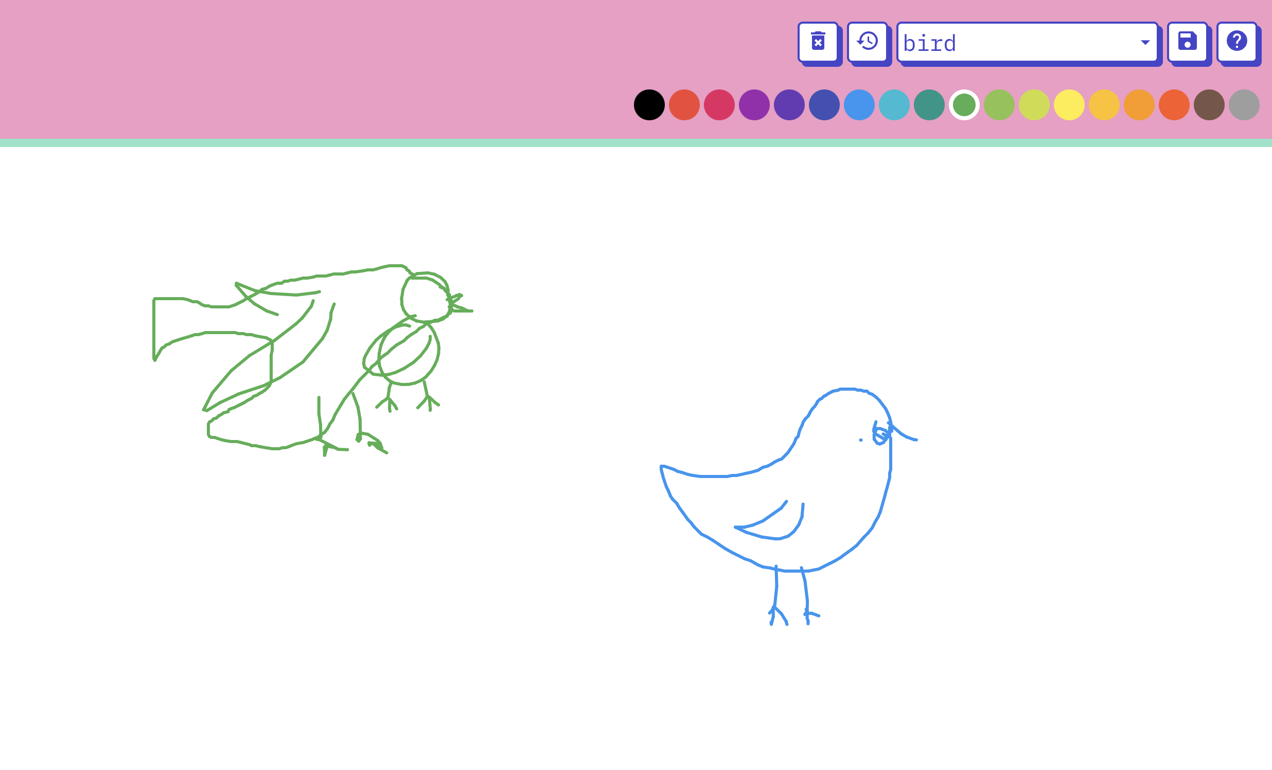
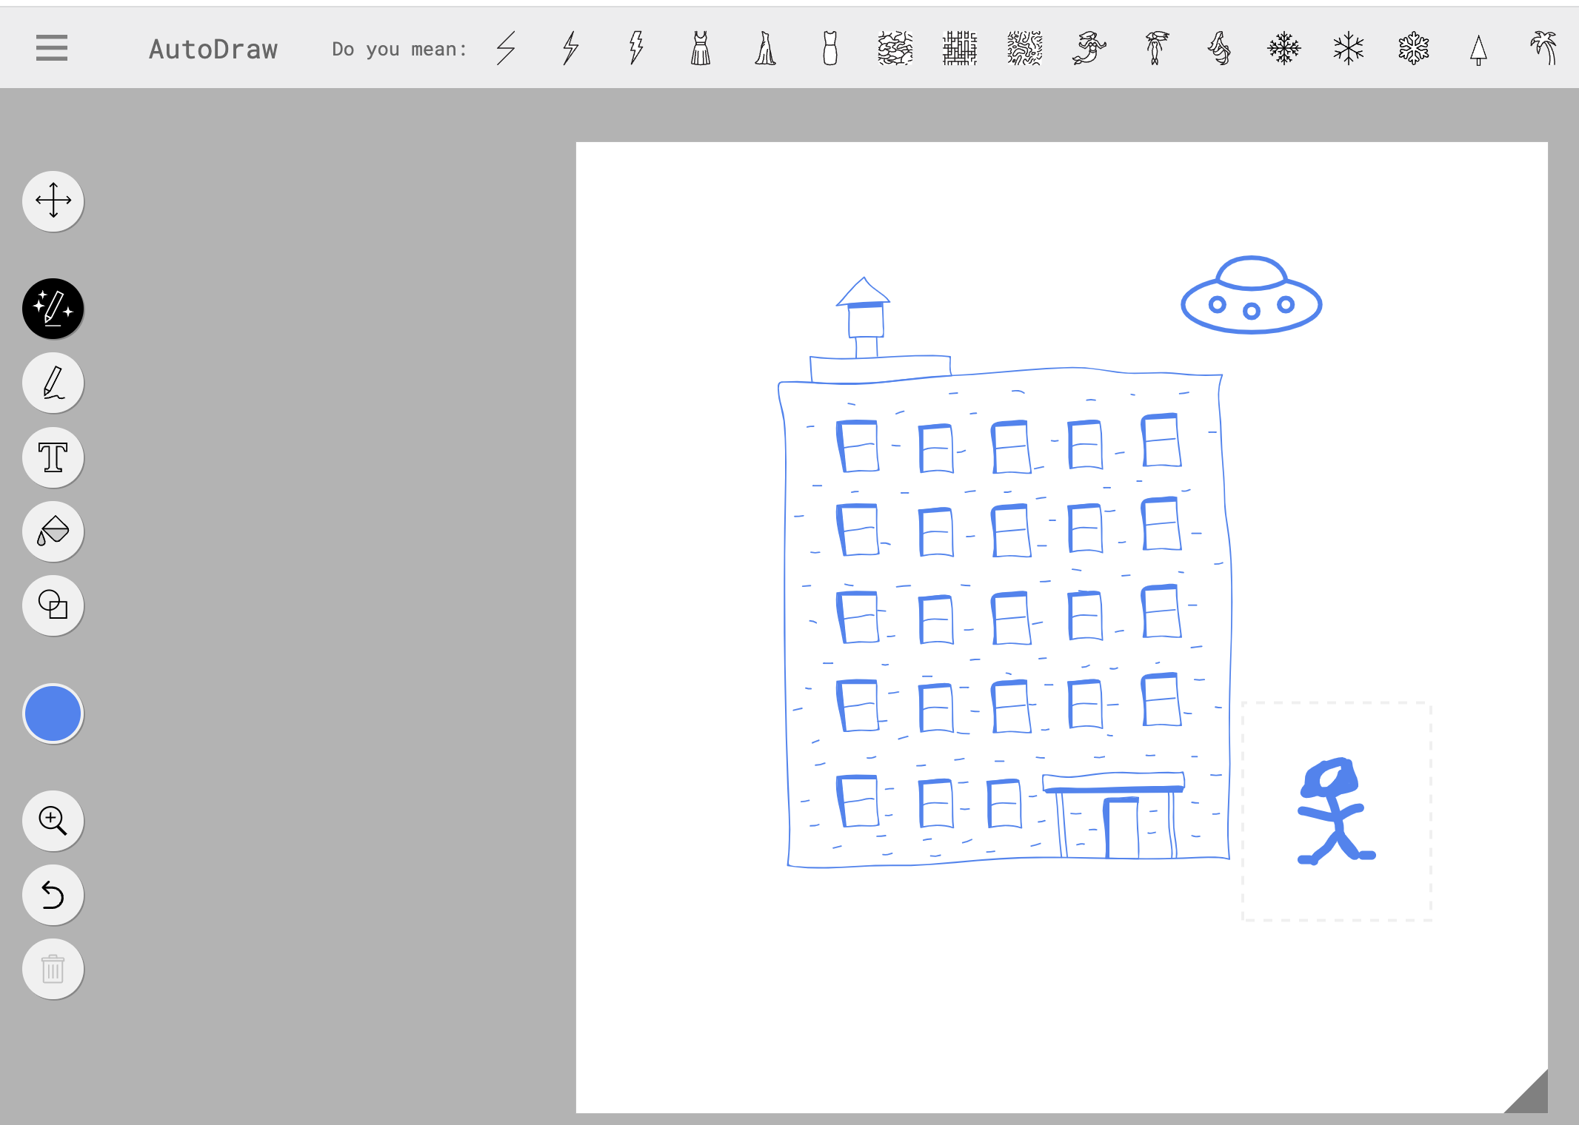
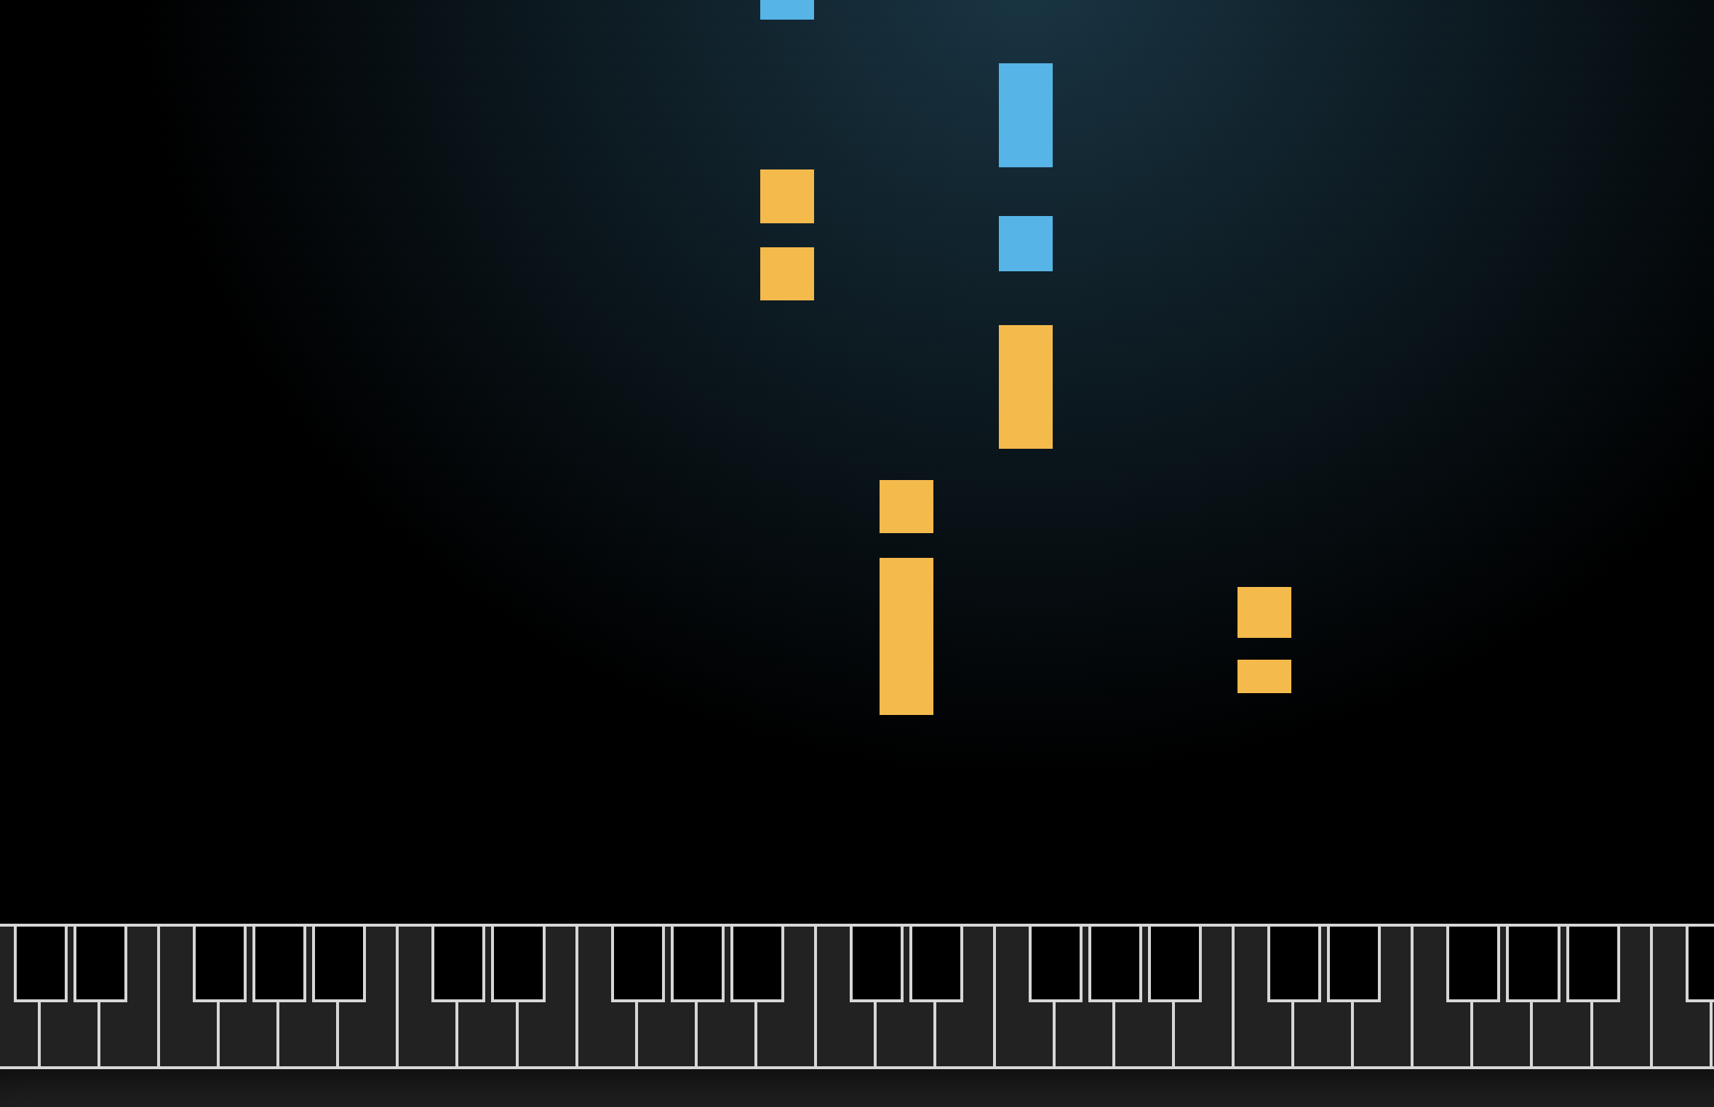
Choose from the following apps (easy)
Magic Sketchpad | Autodraw | AI Duet
This application will automatically finish your drawings for you https://magic-sketchpad.glitch.me/ | This application tries to recognize what you draw. https://www.autodraw.com/ | This application plays piano together with you https://experiments.withgoogle.com/ai/ai-duet/view/

Slide 4
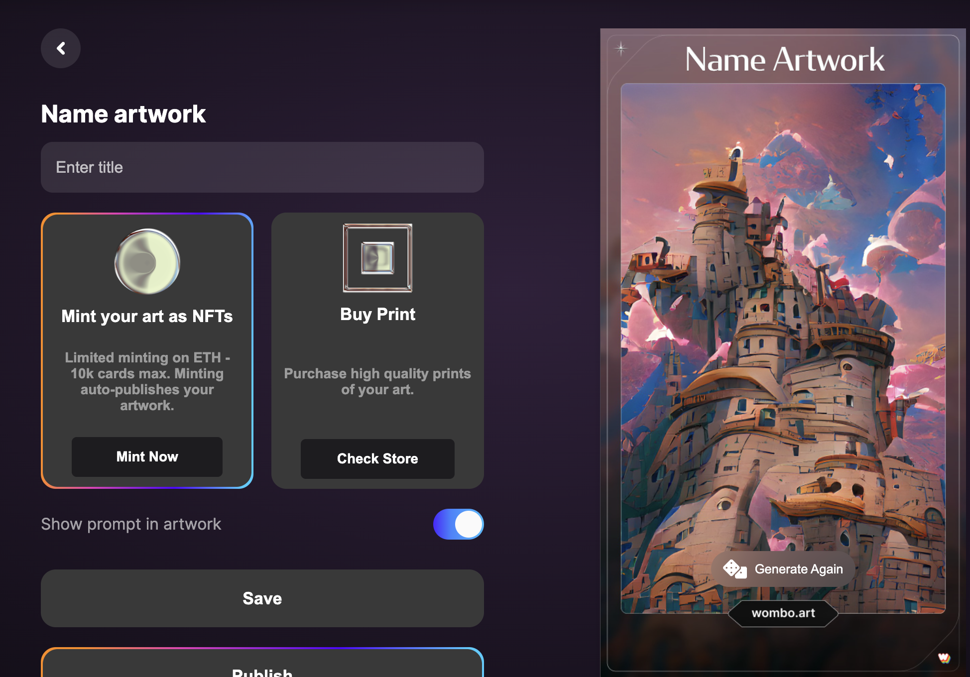
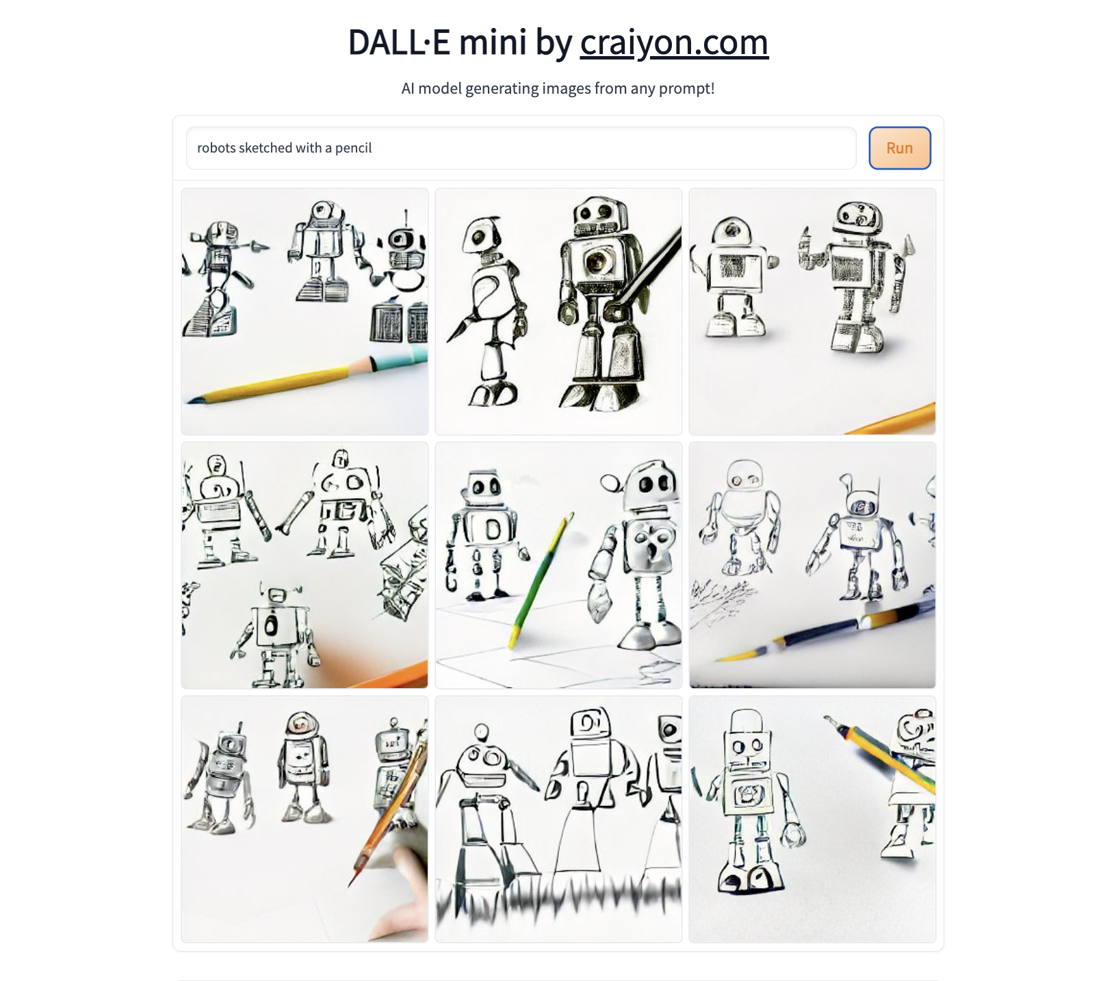
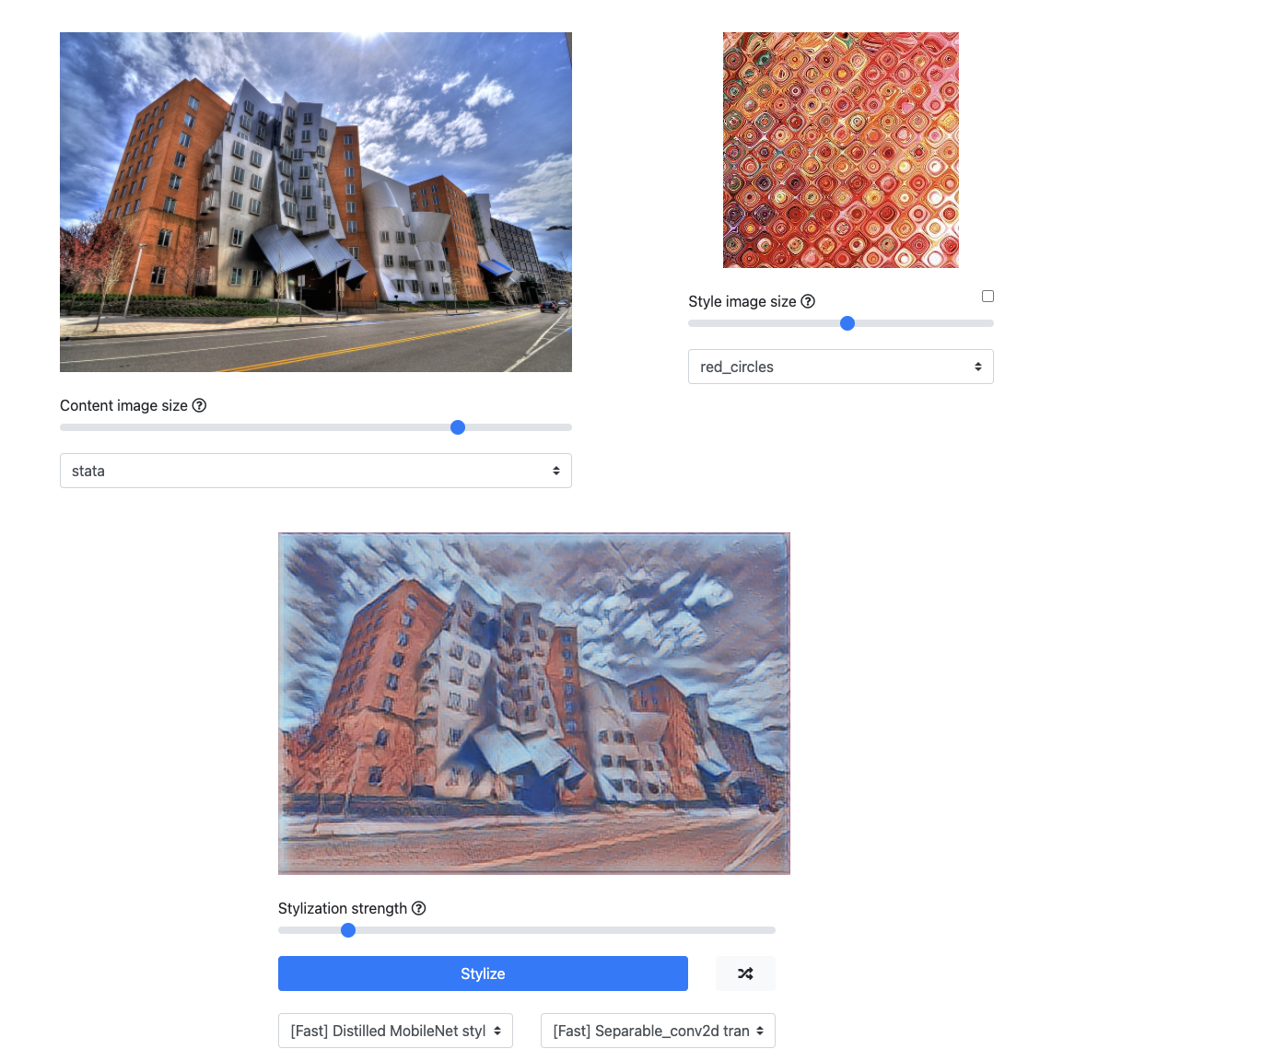
Choose from the following apps (intermediate)
Wombo Dream | DALL-E Mini | Arbitrary Style Transfer
This app transforms text into a painting. https://app.wombo.art/ | This app transforms text suggestions in 9 different pictures. https://huggingface.co/spaces/dalle-mini/dalle-mini | This app transfers a style from one picture to another and transforms this photo into a painting. https://reiinakano.com/arbitrary-image-stylization-tfjs/

Slide 5
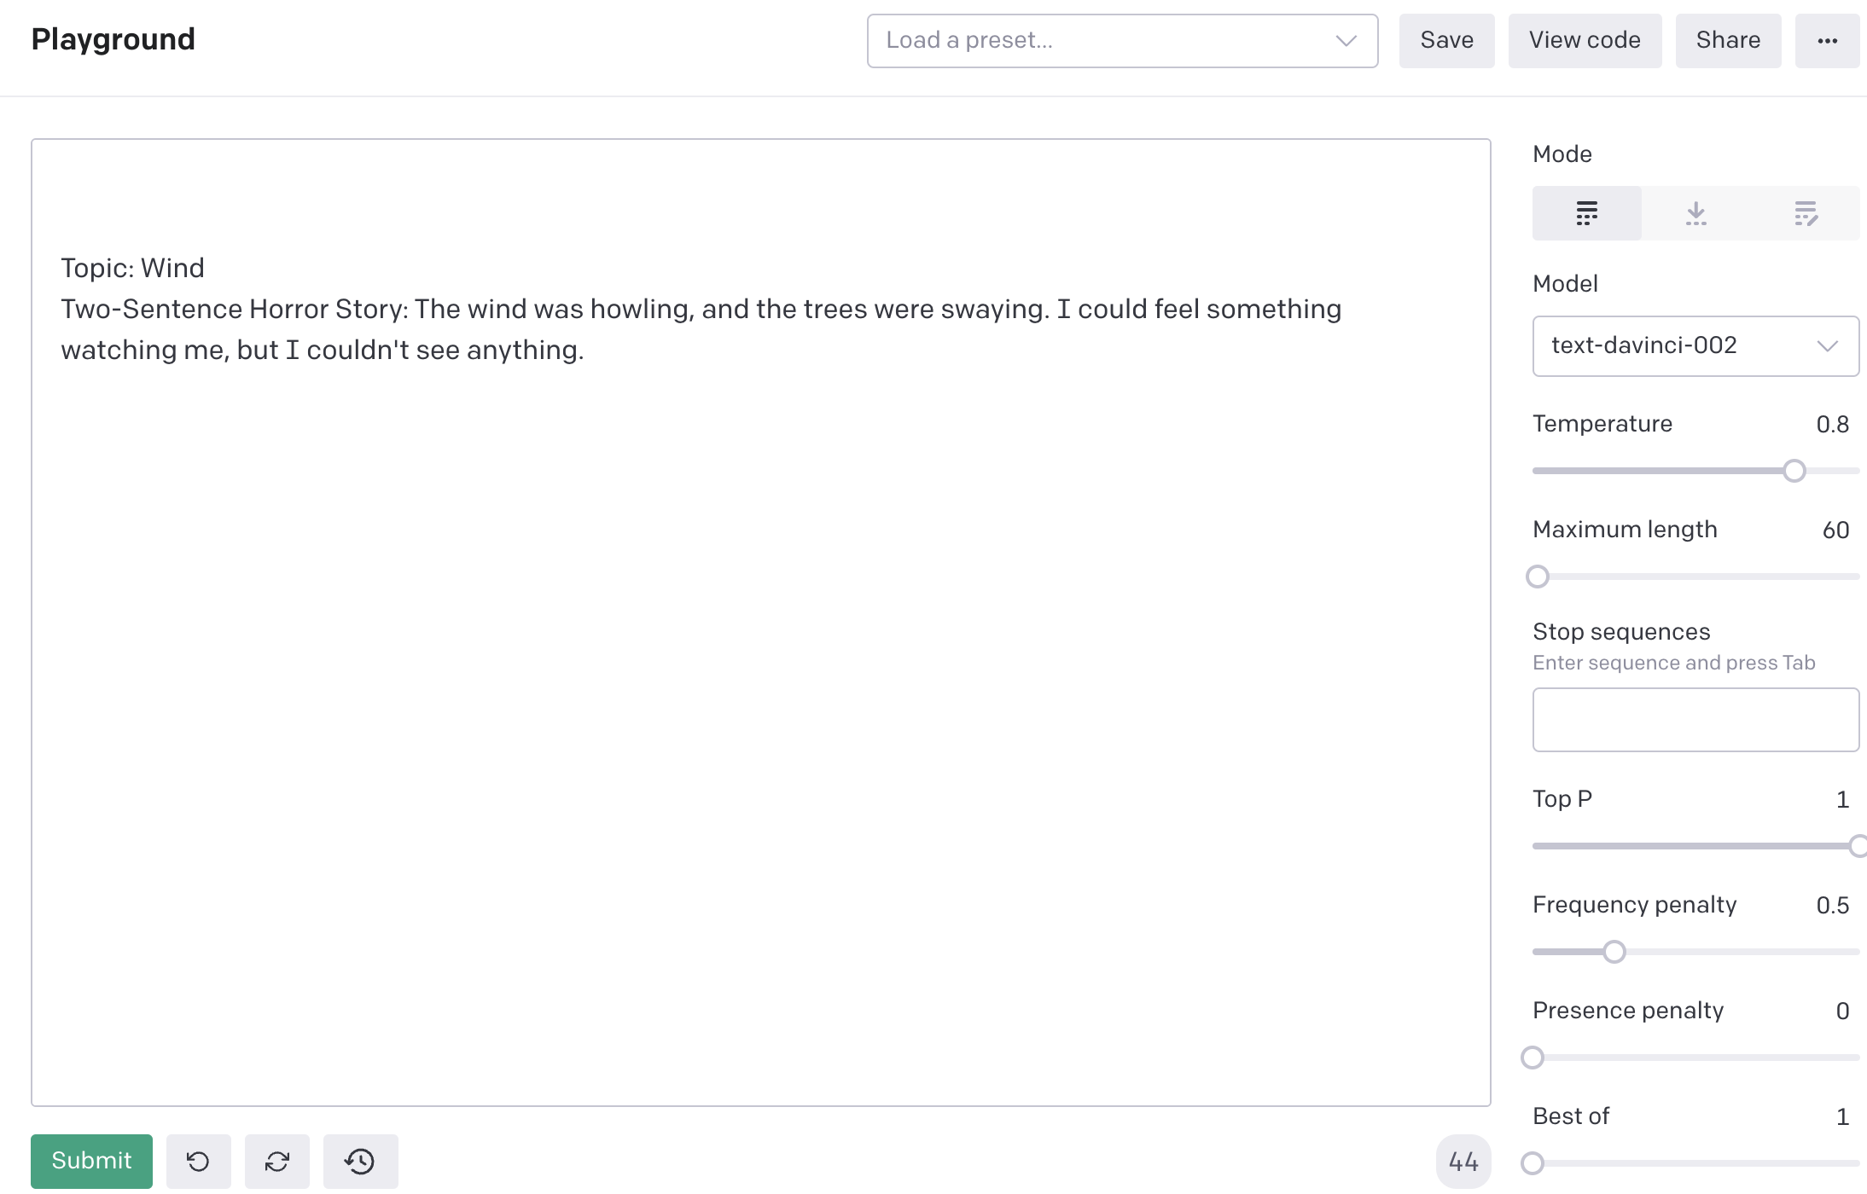
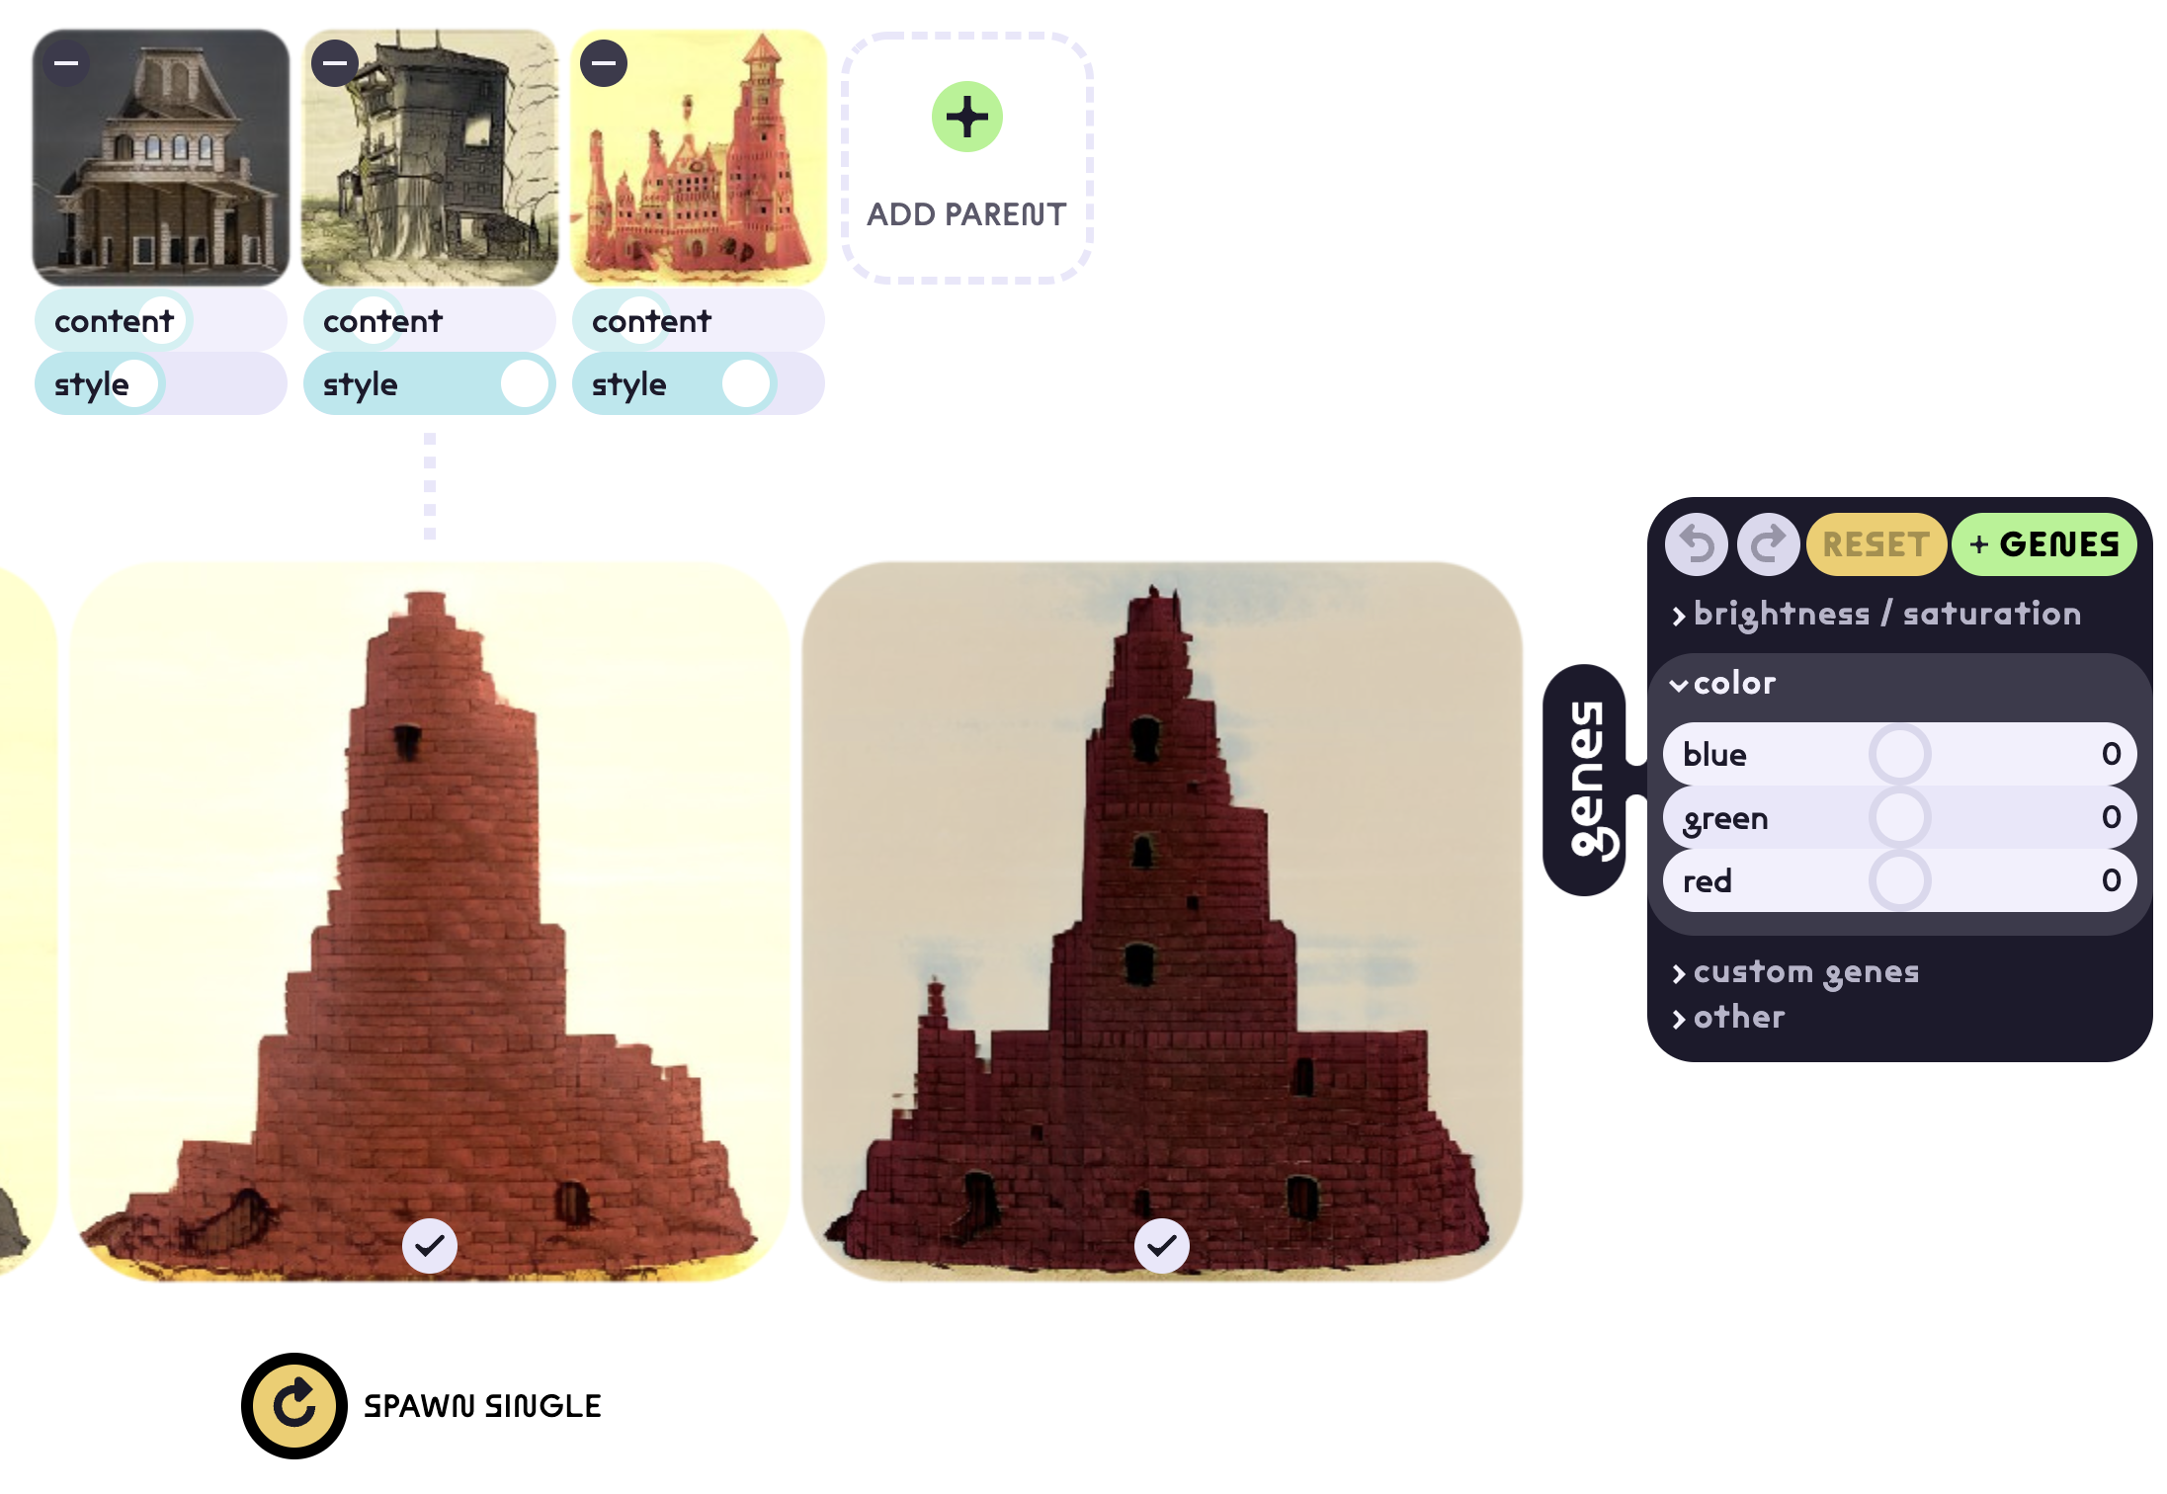
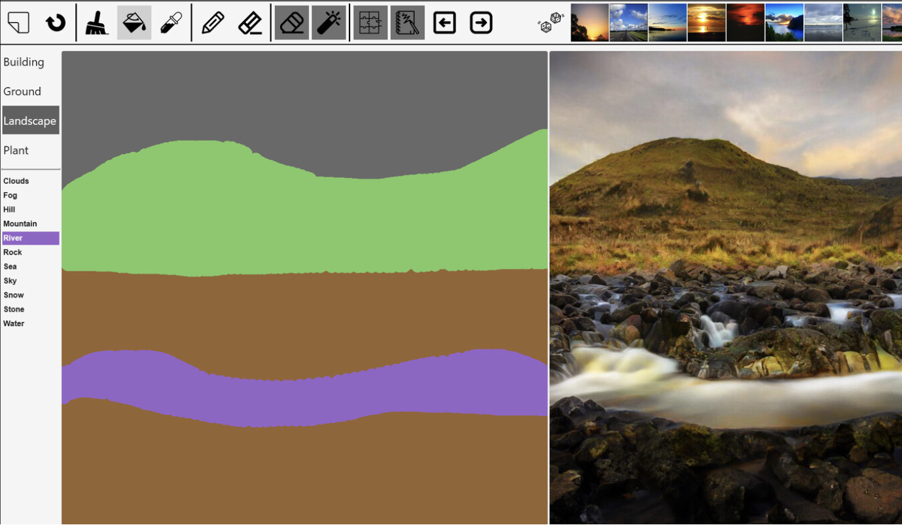
Choose from the following apps (expert)
Horror Story Maker (Open AI) | Gaugan | Art Breeder
This sample application from OpenAi writes short horror stories. Registration required! https://beta.openai.com/playground/p/default-micro-horror?model=text-davinci-002 | This application turns your drawing into realistic images http://gaugan.org/gaugan2/ | Art Breeder is one of the most famous GANs. In this application one can combine the content and style of multiple images. Registration required! https://www.artbreeder.com/

Slide 6
References to further apps
https://magenta.tensorflow.org/demos
https://www.eloquentron3000.com/
https://beta.openai.com/overview
https://artsandculture.google.com/project/manga

